Slide 1
Anna Simonova fINAL project

Slide 2
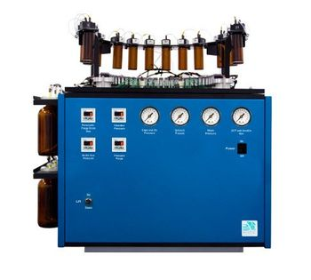
Introduction
Antisense
Sense
Duplex
one screen = 192 duplexes = 192 AS + 192 S
48 strands one screen= 8 runs of synthesizer

Slide 3
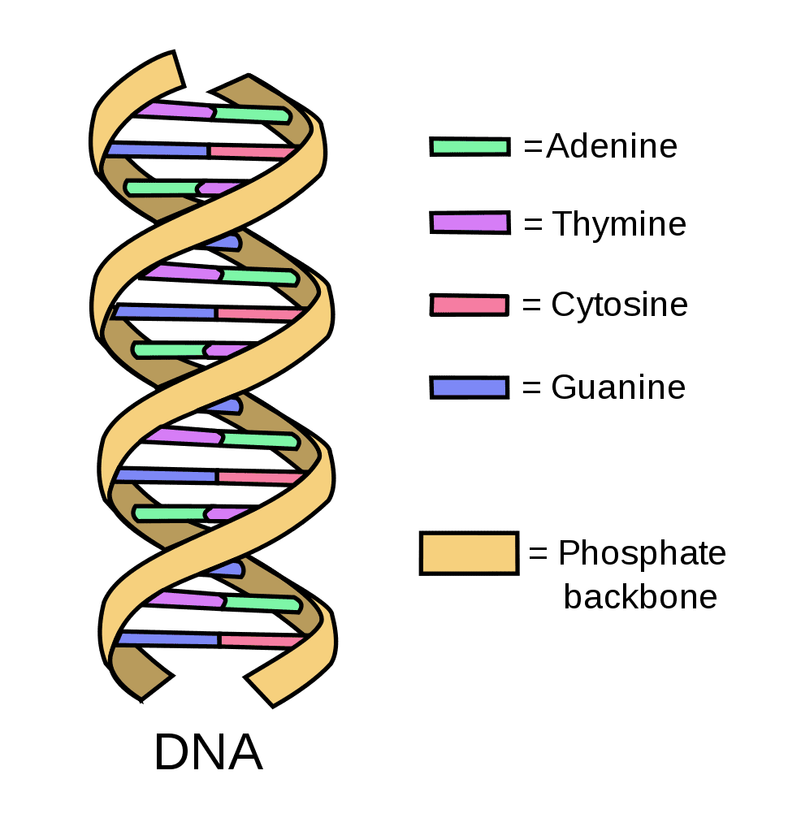
Oligo Pattern
(mG)#(mG)#(fA)#(fU)#(mG)(fC)(mU)(fG)(fC)(fG)(mC)(mC)(fU)(fC)#(mU)#(mA)
fhfmIKIKIKFFImfF

Slide 4
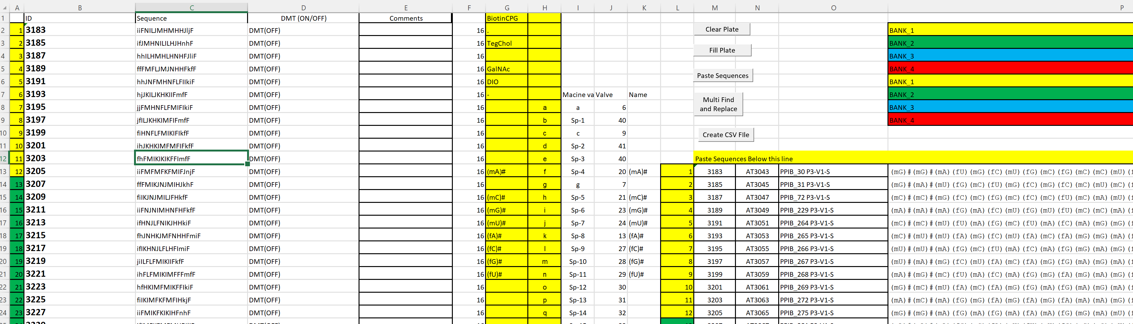
Current workflow

Slide 5
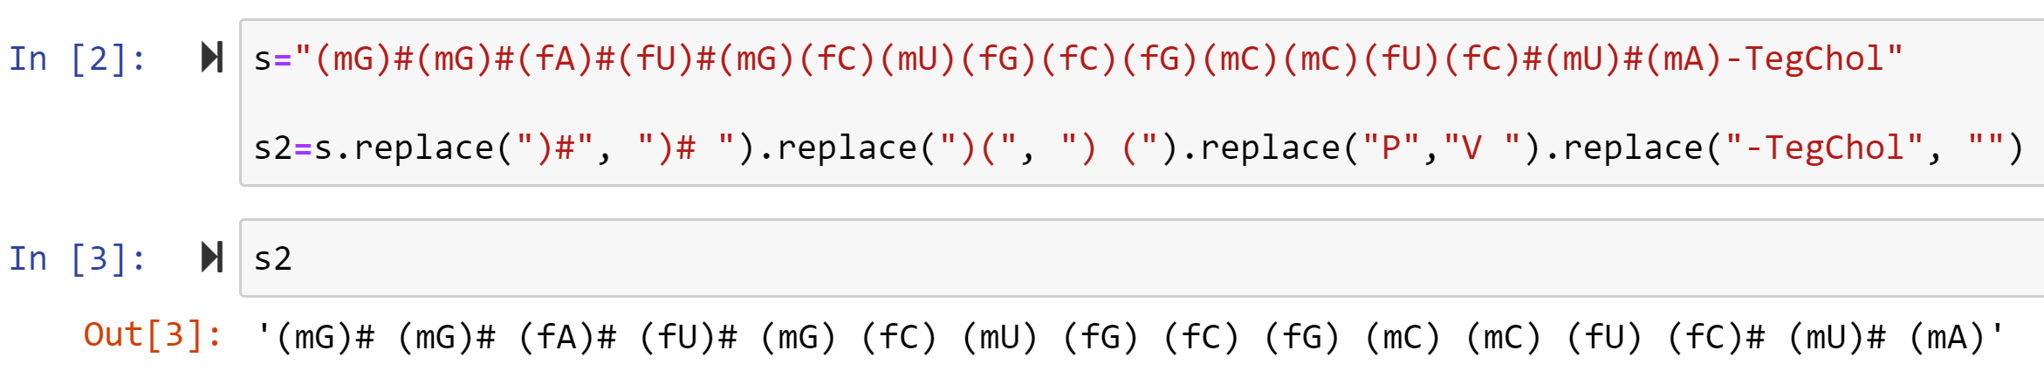
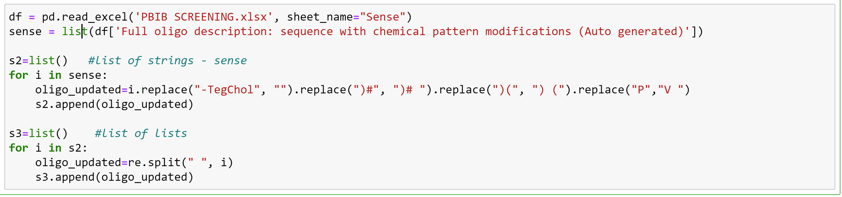
String to list

Slide 6
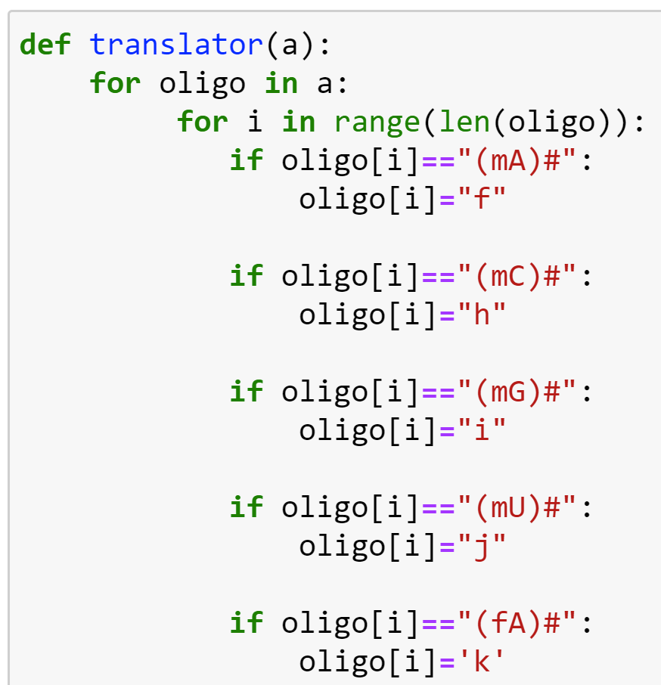
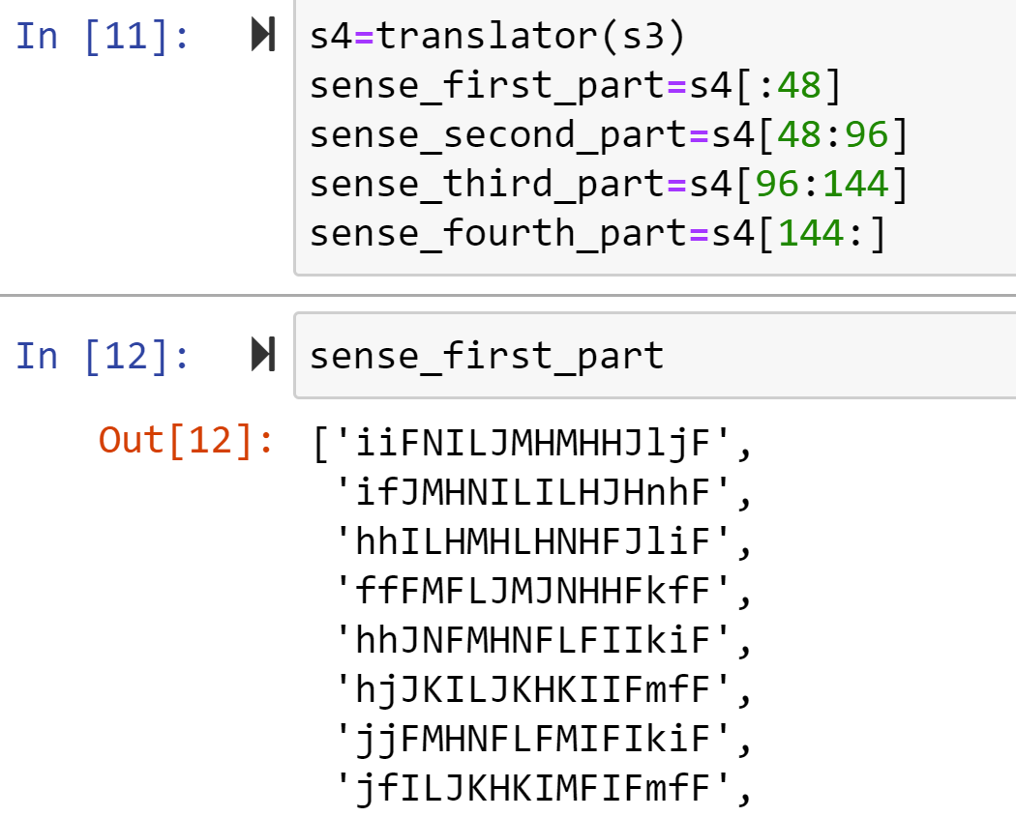
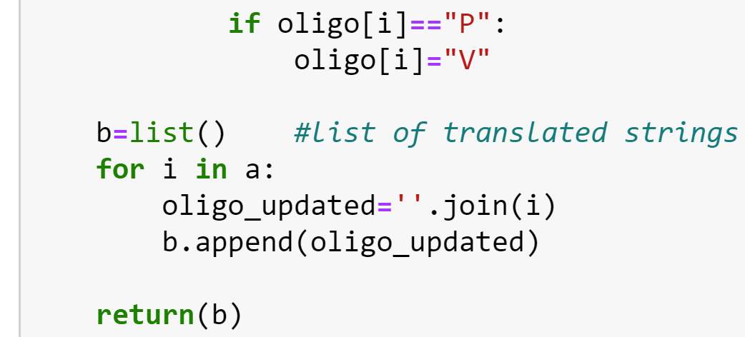
Translation step
…

Slide 7
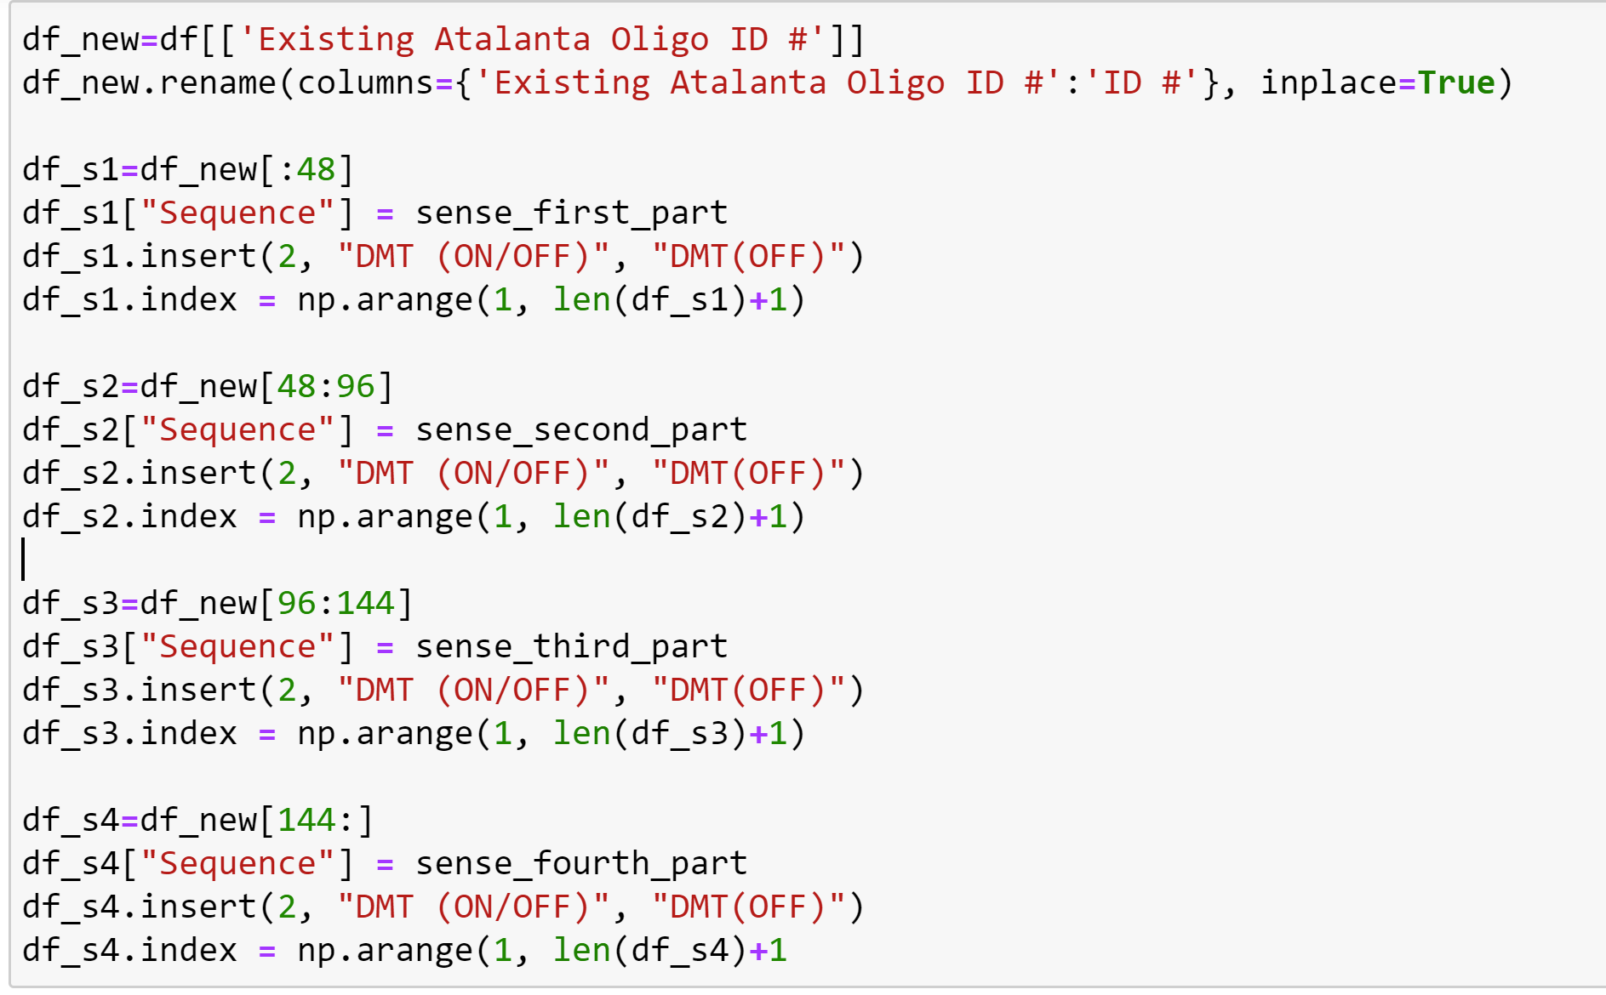
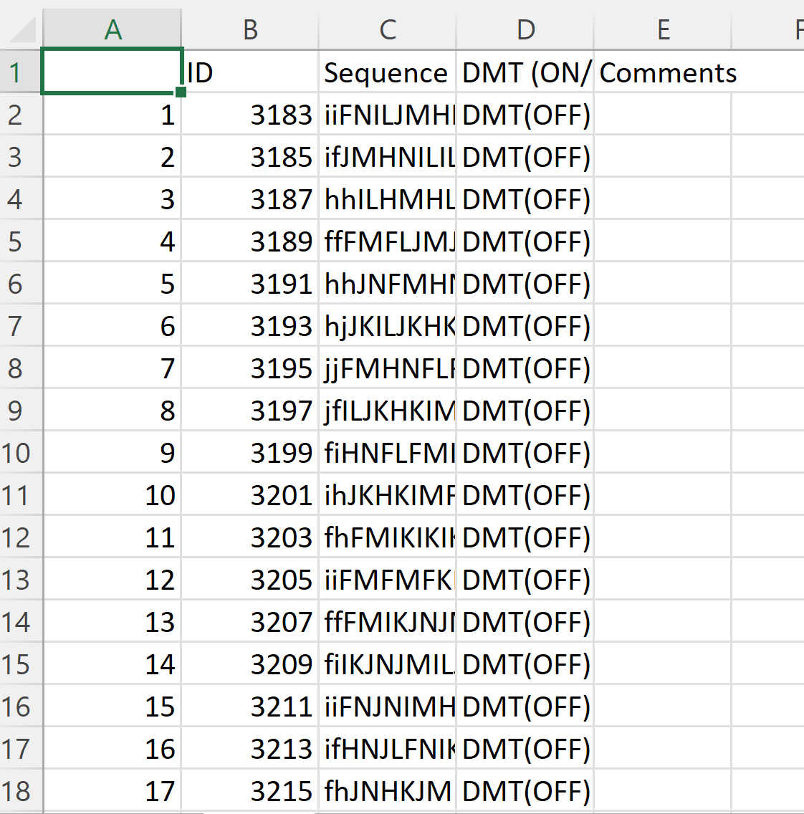
Creating CSV file

Slide 8
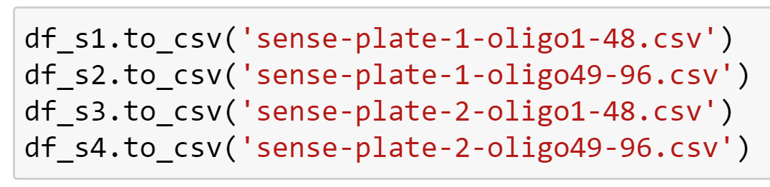
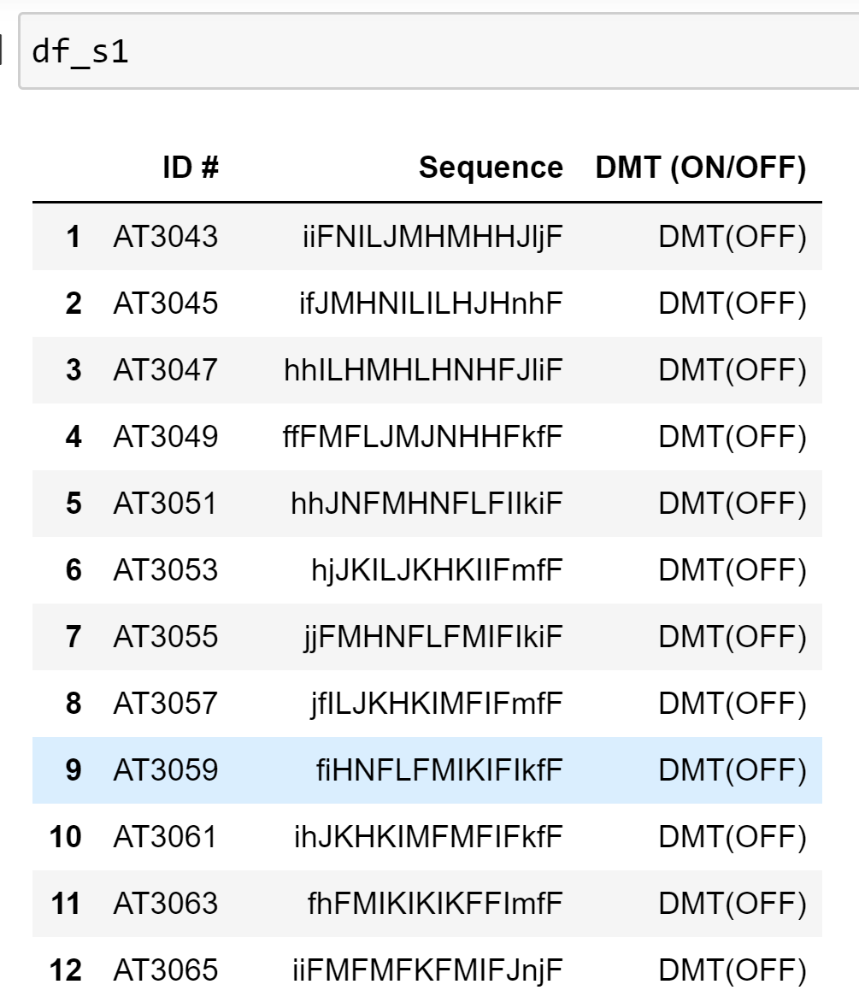
Final result

Slide 9
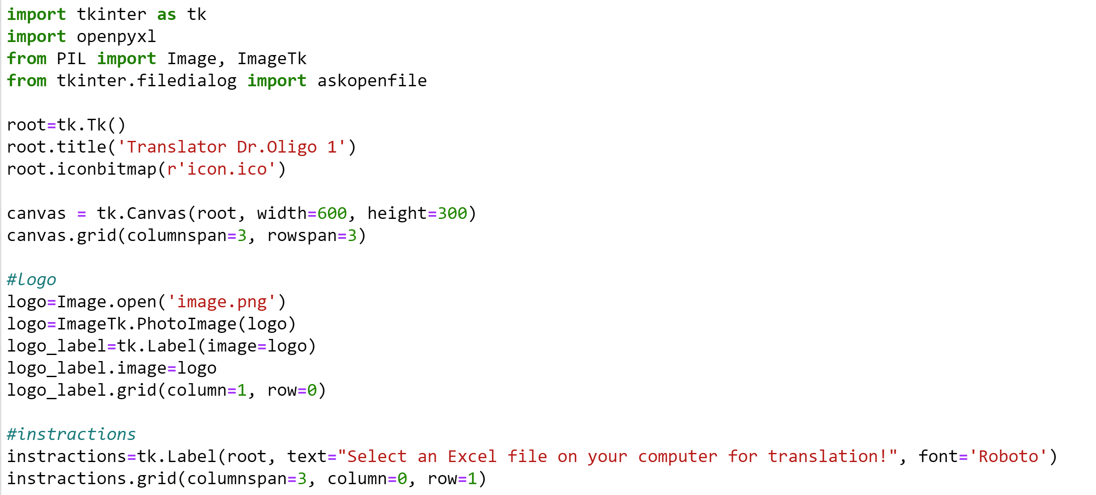

Tkinter GUI
Root=tk.Tk()
…
Root.mainLoop()
MY CODE!
https://www.youtube.com/watch?v=itRLRfuL_PQ&t=21s

Slide 10
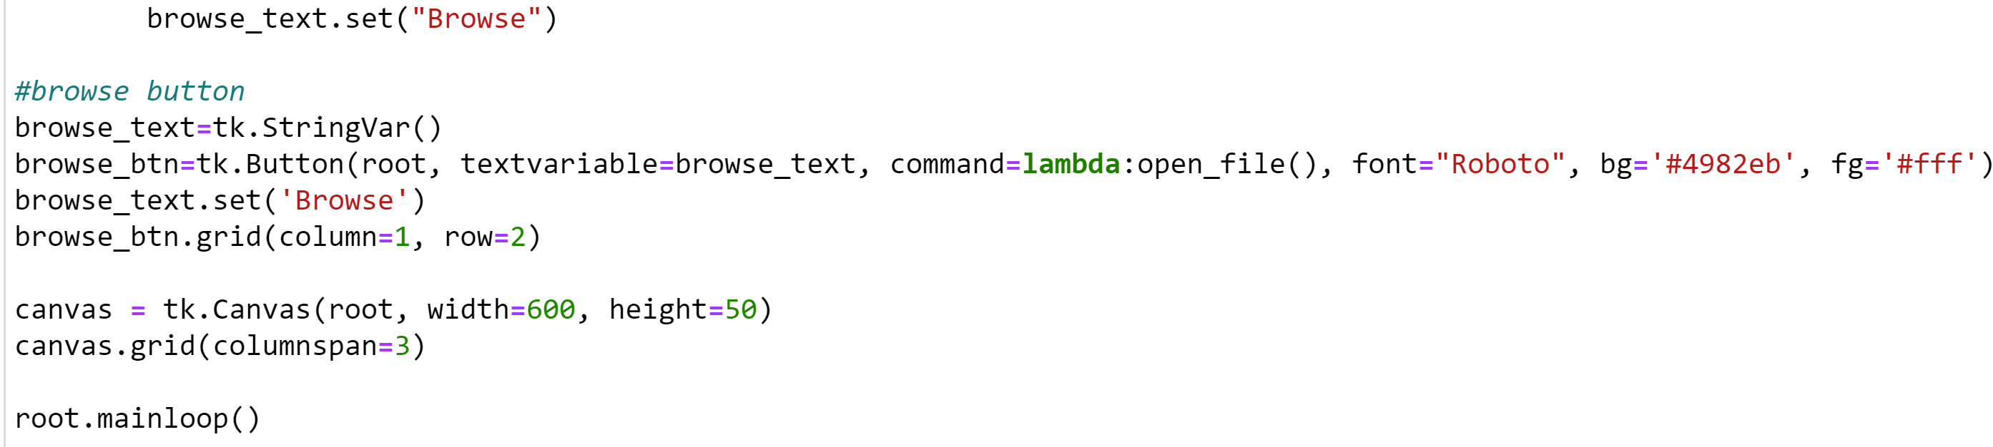
Button
MY CODE!

Slide 11

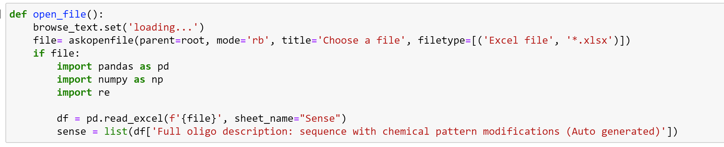

File name
BUT!

Slide 12
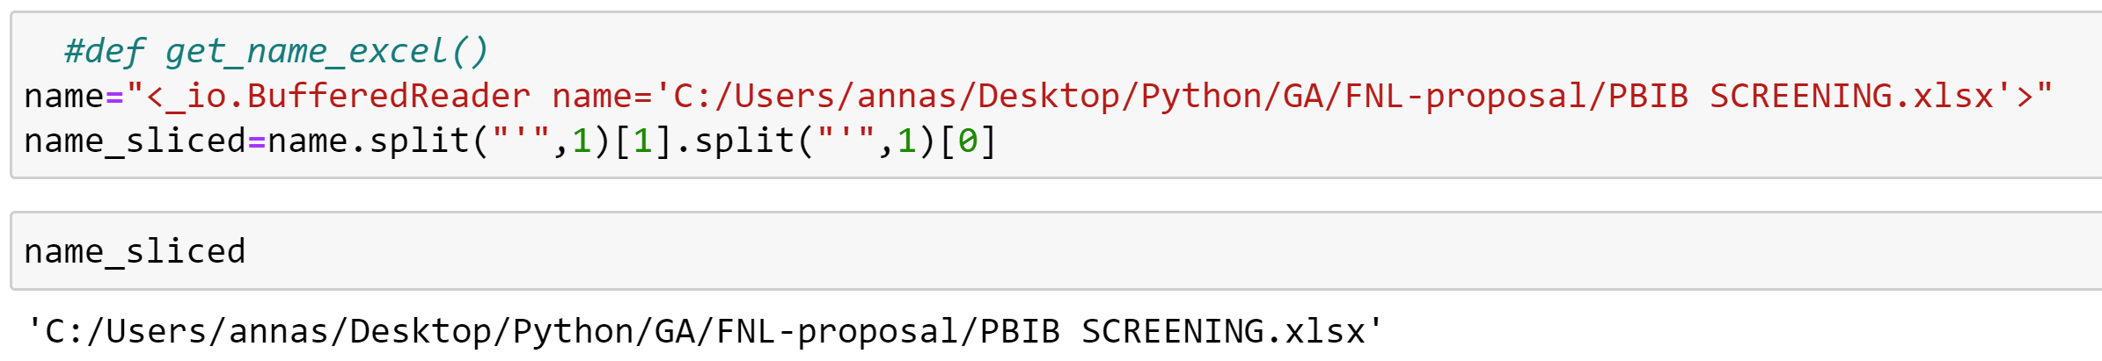
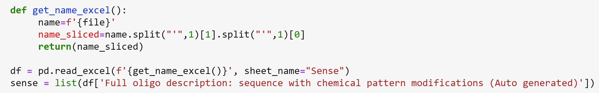
File name

Slide 13
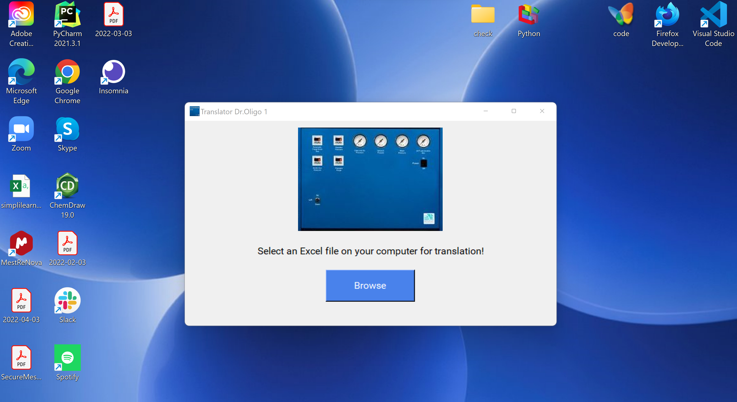


Slide 14
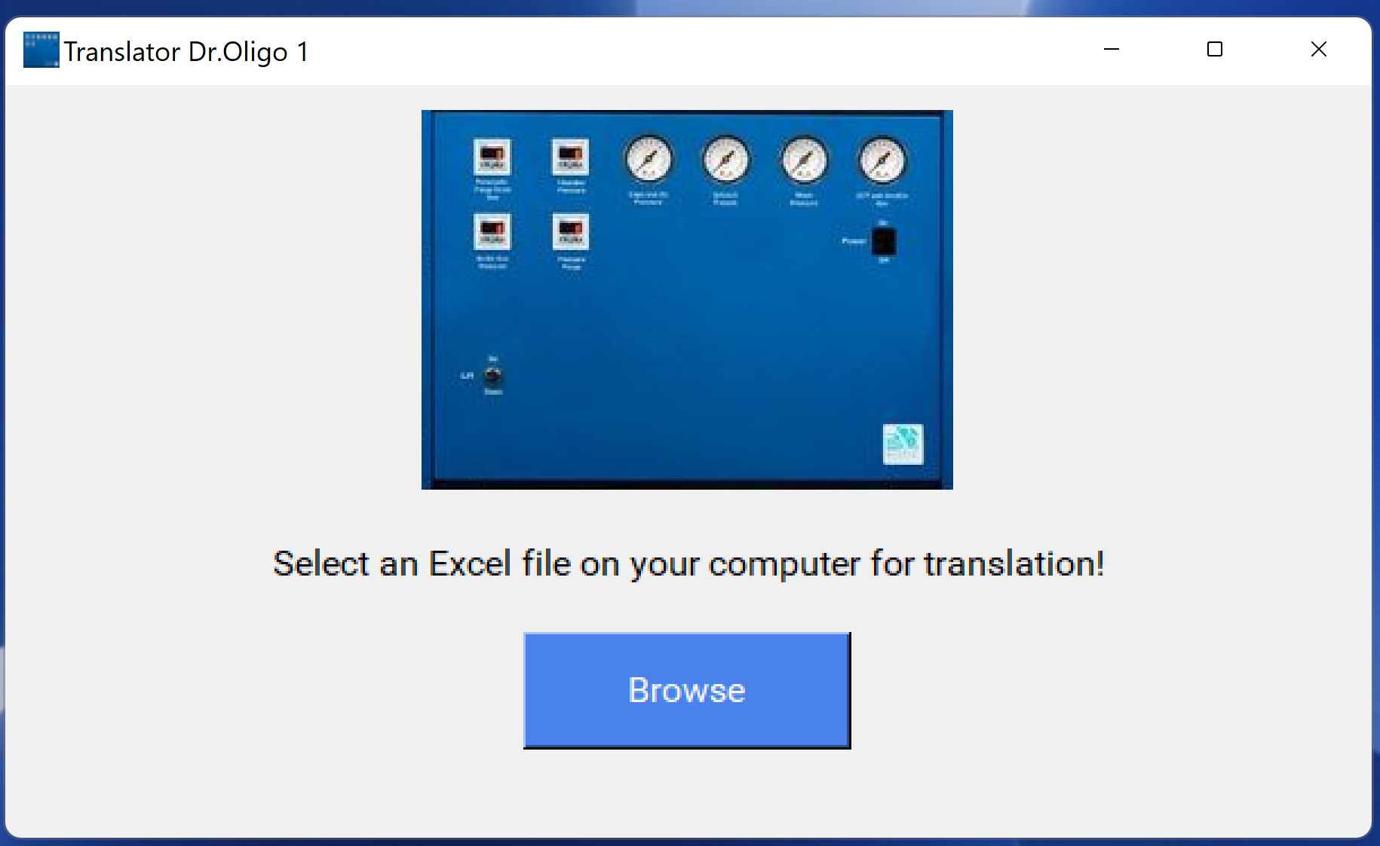

Slide 15
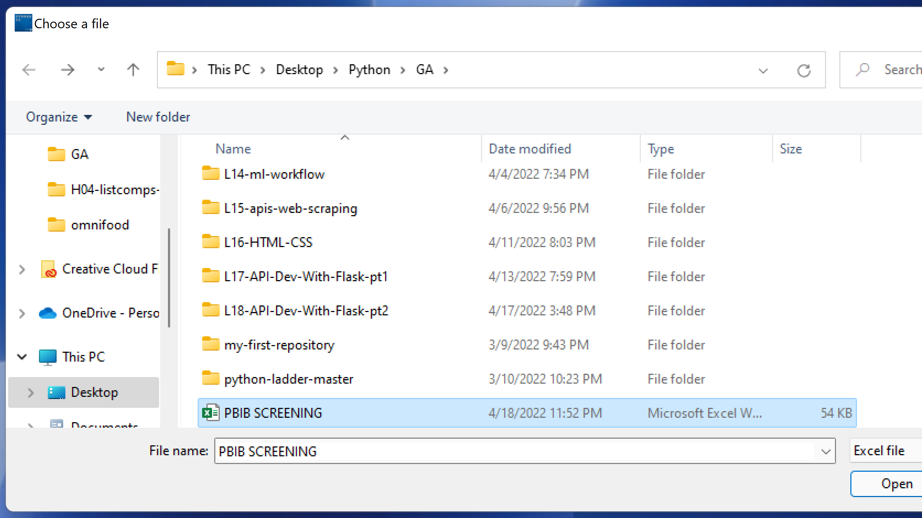

Slide 16
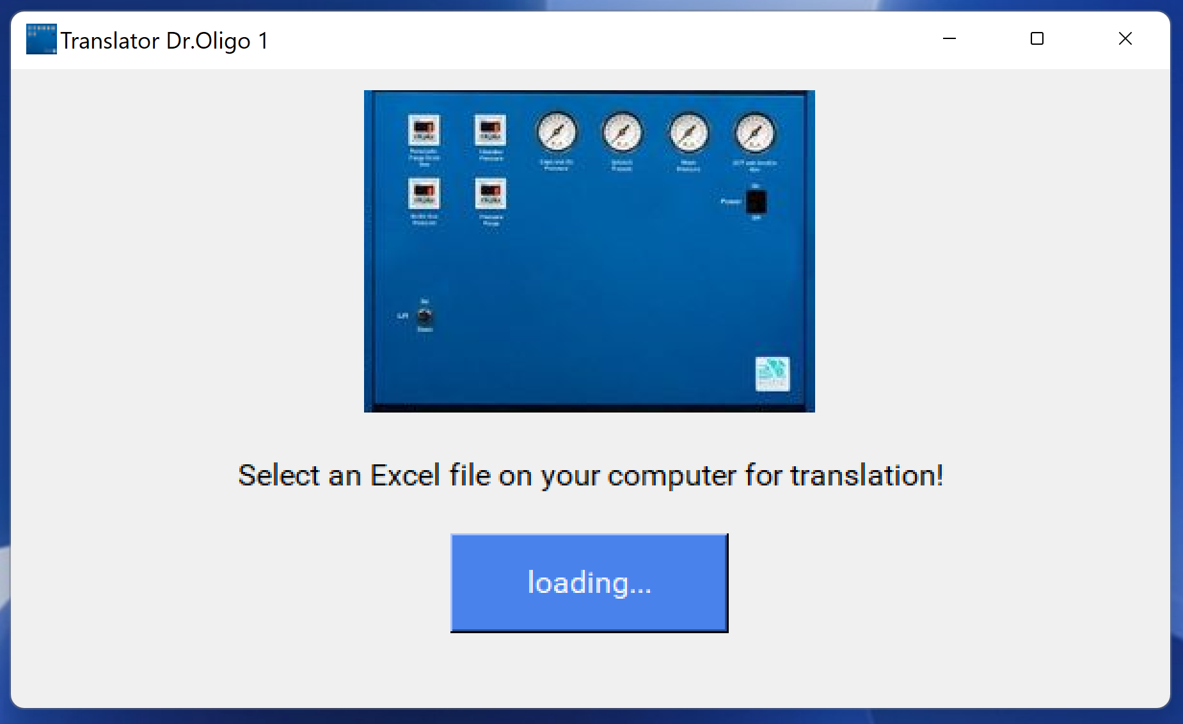

Slide 18
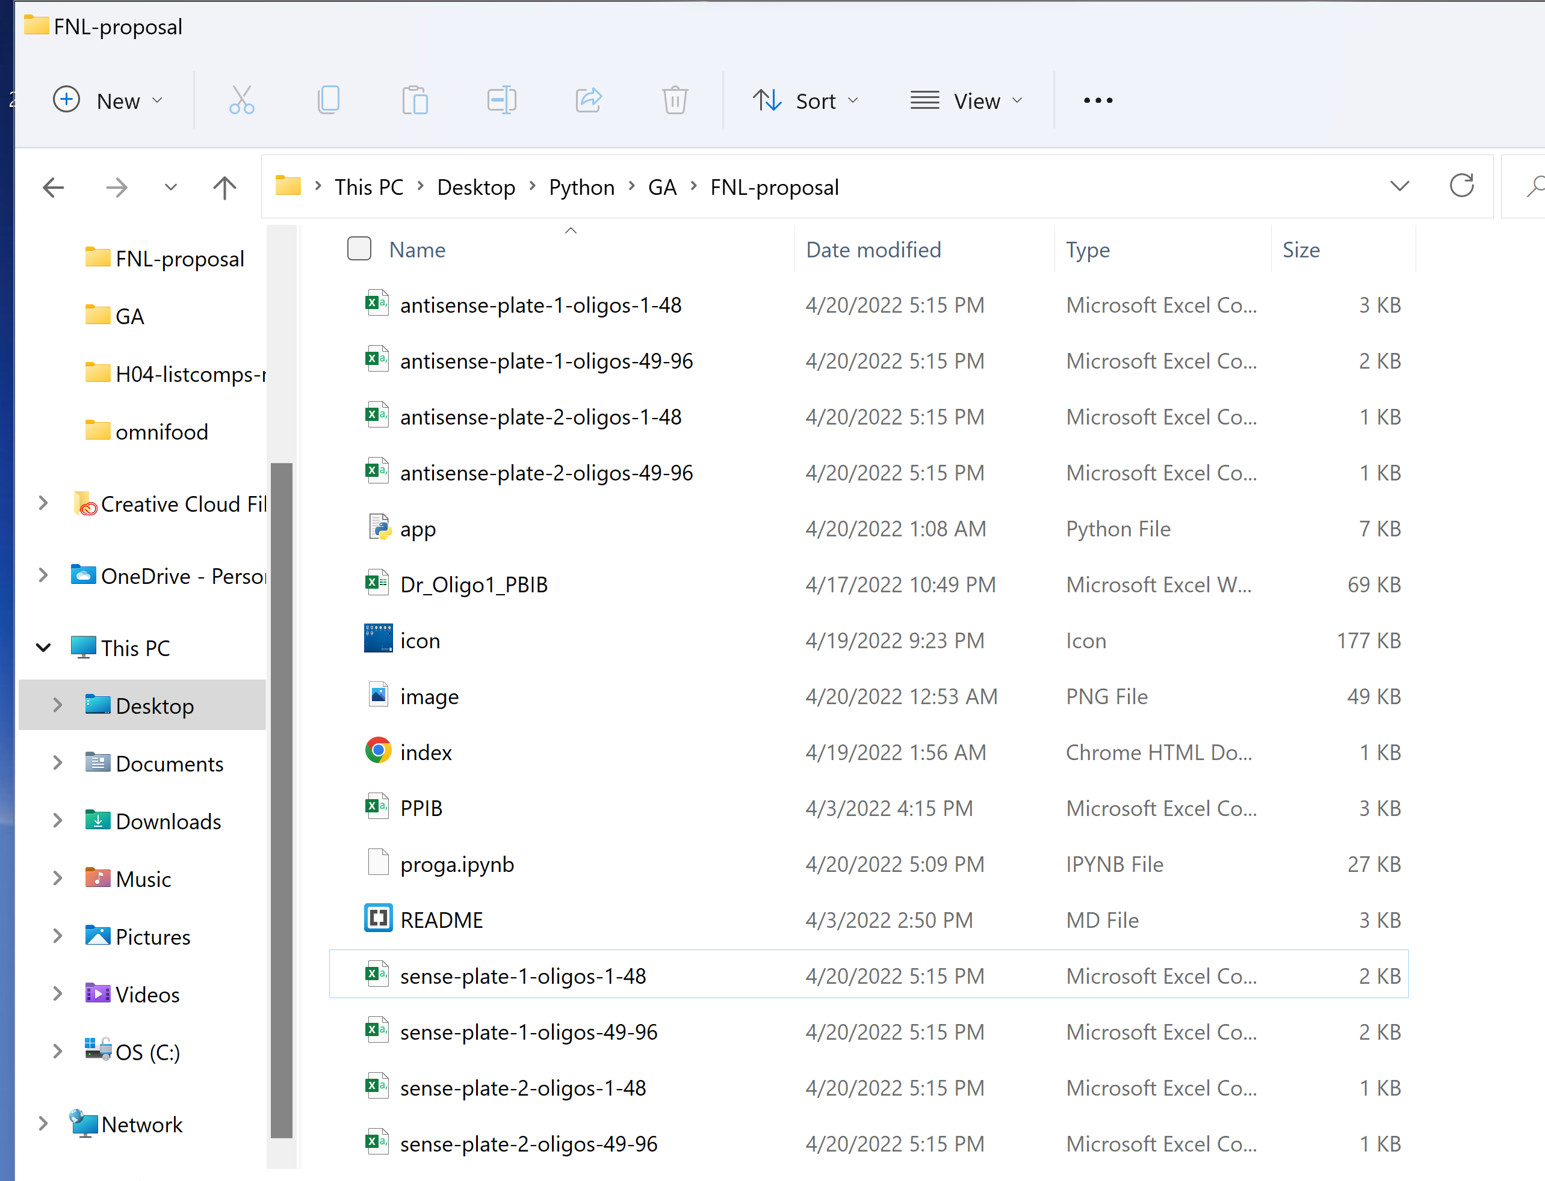
CSV files

Slide 19
Thank you for attention!

